Slide 1

NASA Arizona Space Grant Symposium
2025
Casa Grande Union High School Near Space Research Team

Slide 2
ASCEND! Aerospace STEM Challenges to Educate New Discoverers
University of Arizona
Arizona State University
Embry-Riddle Aeronautical University
Arizona Western College
Glendale Community College
Pima Community College
Central Arizona College (Signal Peak)
Phoenix College
and Casa Grande Union High School
ASCEND!" (Aerospace STEM Challenges to Educate New Discoverers) is an Arizona Space Grant Consortium statewide Workforce Development program designed to involve undergraduate students from across Arizona in the full "design-build-fly-operate-analyze" cycle of a space mission.

Slide 3
CGUHS Near Space Research Team
Project Manager
Landri Howard
Prototype Development
Hailianna Rodgers
Peyton Posey
Control System
Emily Geen
Enclosure
Zacheriah Buchanan
Aliceanna Villanueva
Axel Carrera
Documentarian
Rayne Tarman

Slide 4
Mission Statement
The CGUHS Near Space Research Team will design, construct, test, and fly a high-altitude balloon payload to gather atmospheric data and 4K video during the flight.

Slide 5
CGUHS Near Space Research Team ASCEND Project Roadmap
Phase I: Single Payload Atmospheric Data Collection and Imaging
Goal: Successfully launch and recover a single payload, collecting atmospheric data and capturing high-resolution imagery.
Timeline: Fall 2024, 2-3 months (COMPLETED)

Slide 6
CGUHS Near Space Research Team ASCEND Project Roadmap
Phase II: Dual Payload RF Communication
Goal: Establish two-way RF communication between two payloads, transmitting internal payload temperature data.
Timeline: Spring 2025, 3-4 months

Slide 7
CGUHS Near Space Research Team ASCEND Project Roadmap
Phase III: Air-to-Ground Mesh Network Prototyping
Goal: Establish a mesh network between a balloon payload and three ground-based autonomous rovers.
Timeline: Fall 2025, 4-6 months

Slide 8
CGUHS Near Space Research Team ASCEND Project Roadmap
Phase IV: Multi-Balloon and Ground Rover Mesh Network
Goal: Expand the mesh network to include two balloon payloads and ground rovers.
Timeline: Spring 2026, 3-4 months

Slide 9
Prototype Development
Hailianna Rodgers
Peyton Posey

Slide 10
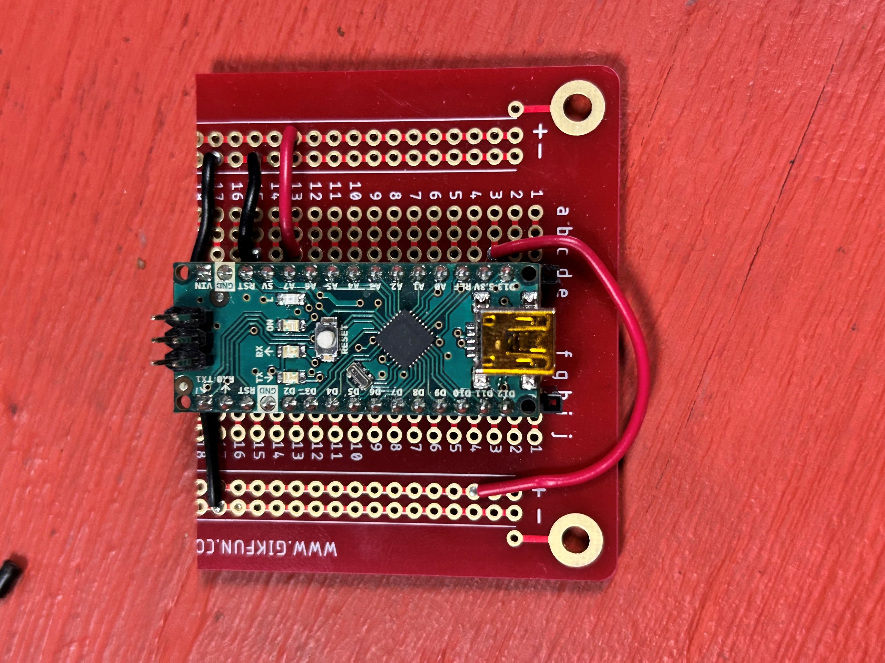
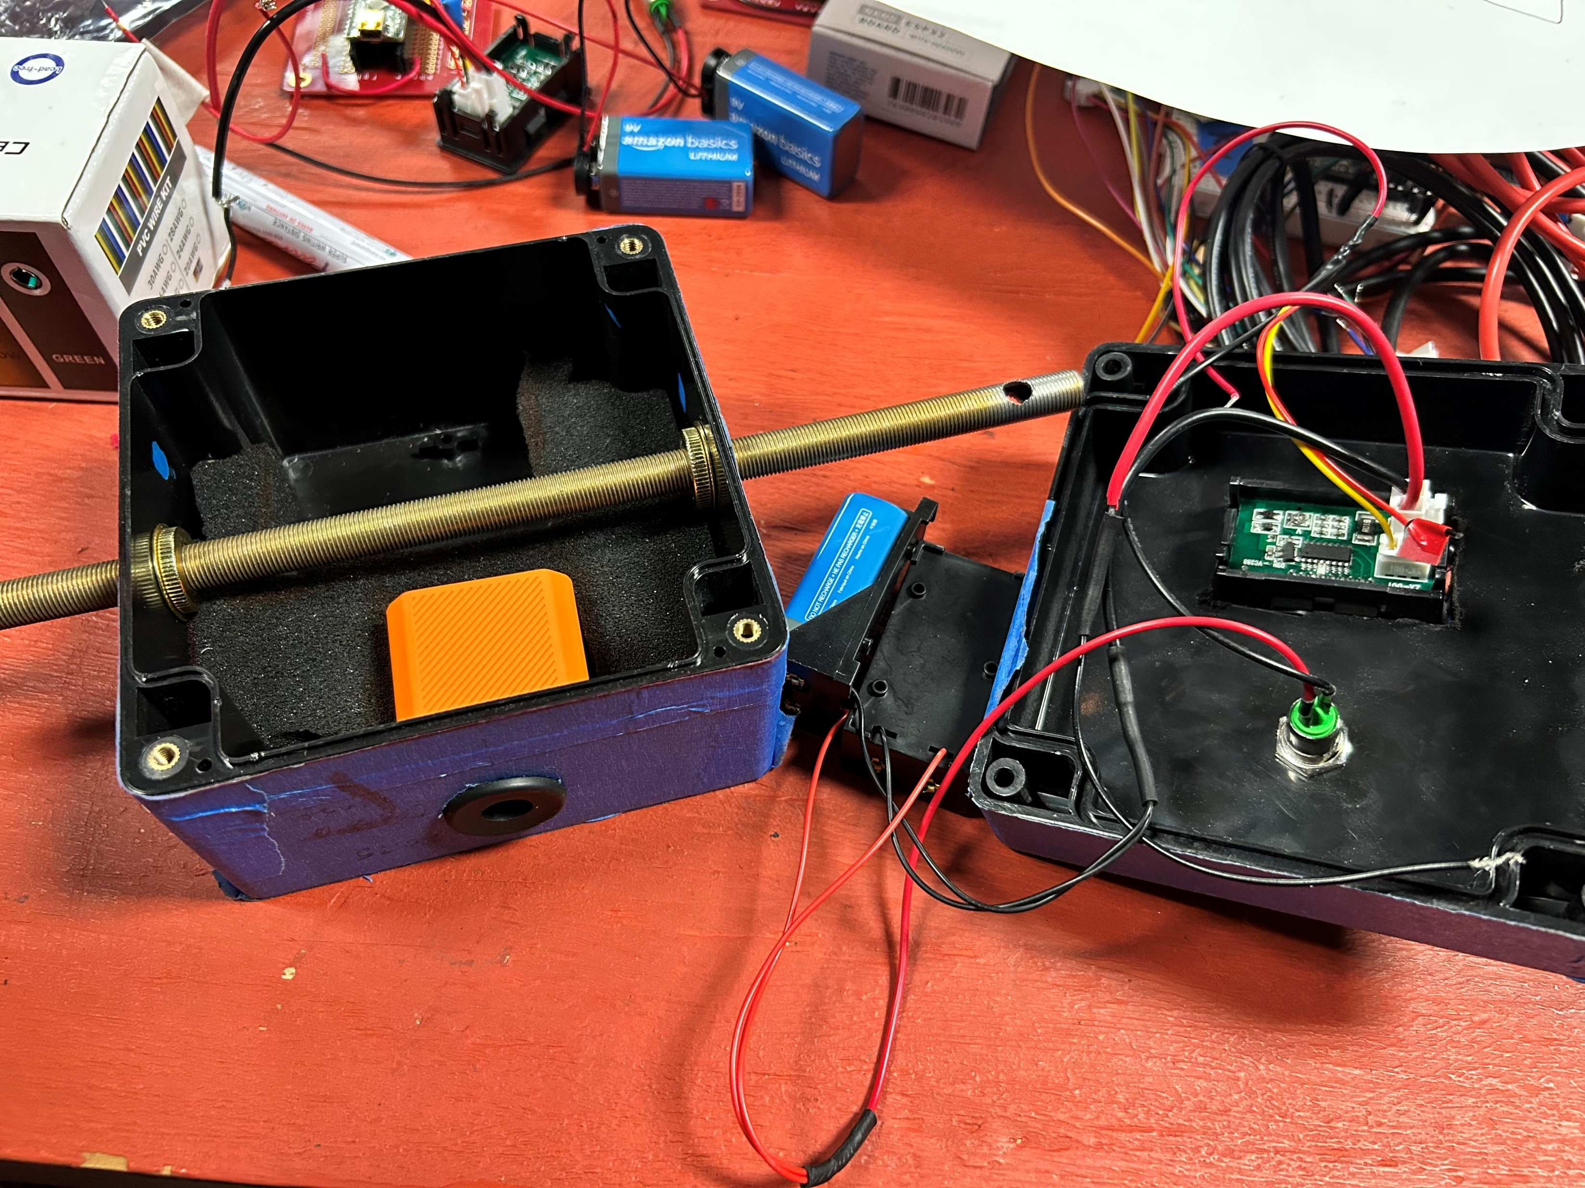
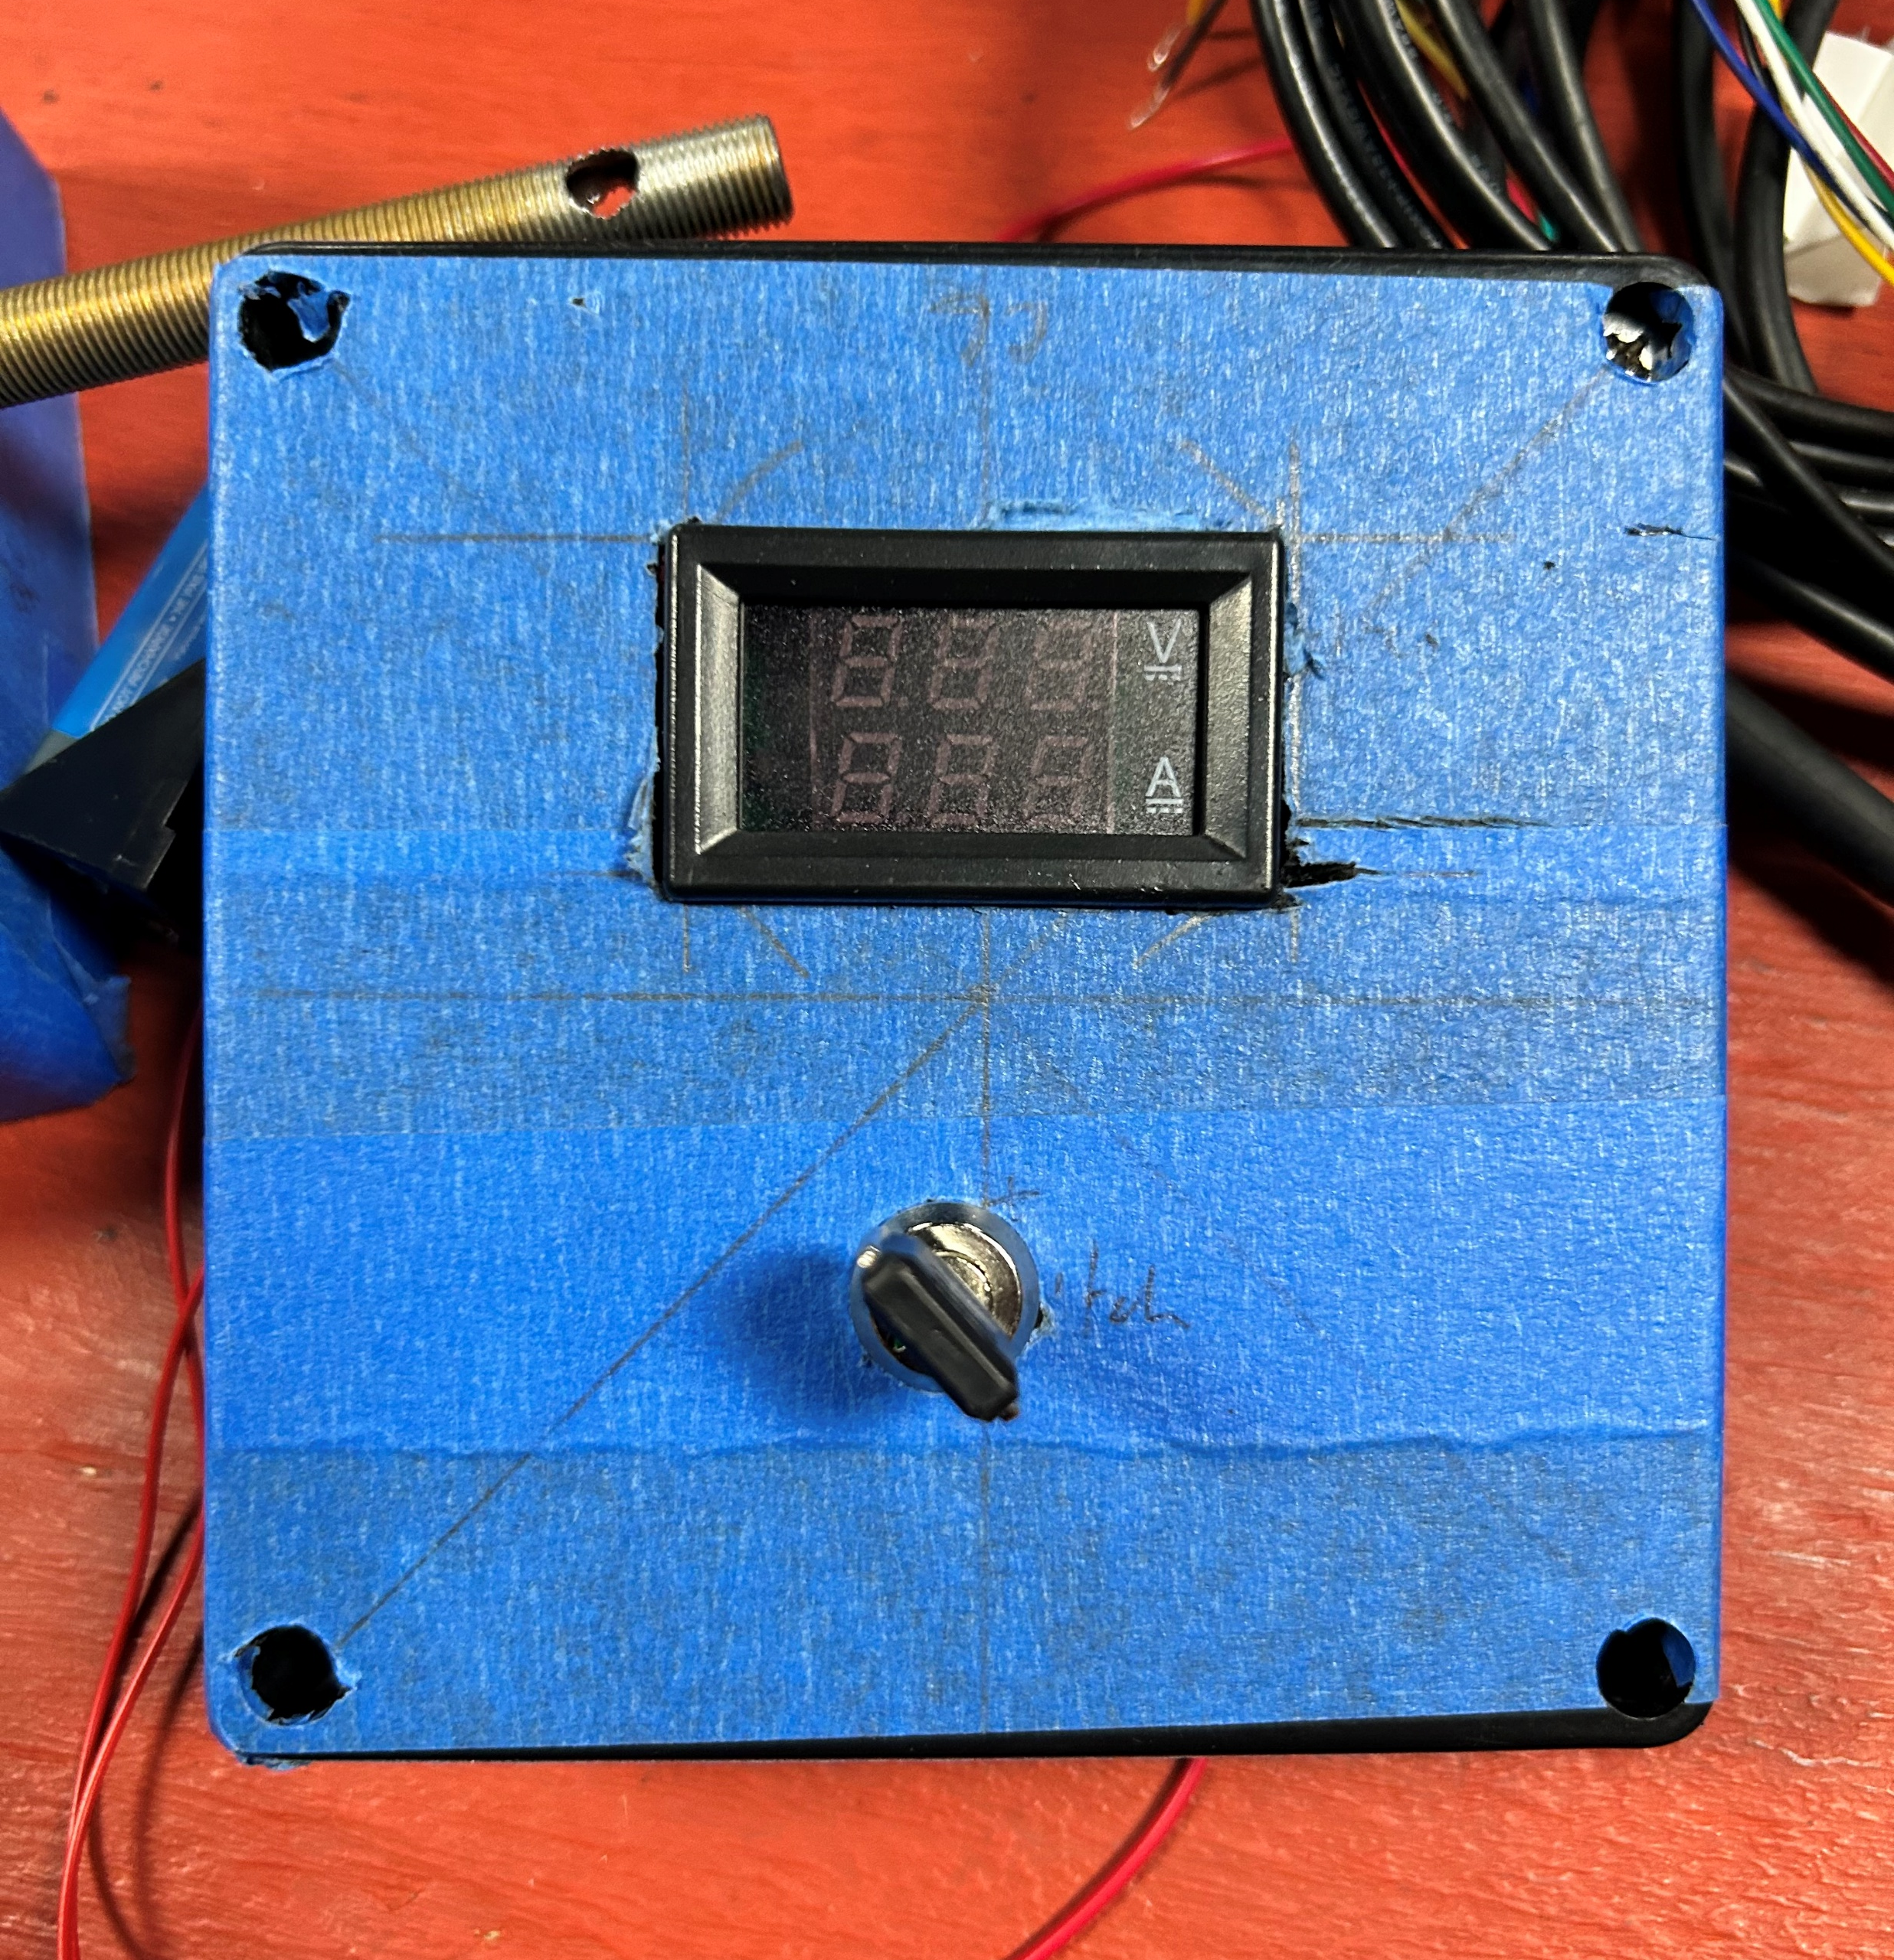
Prototype
Development

Slide 11
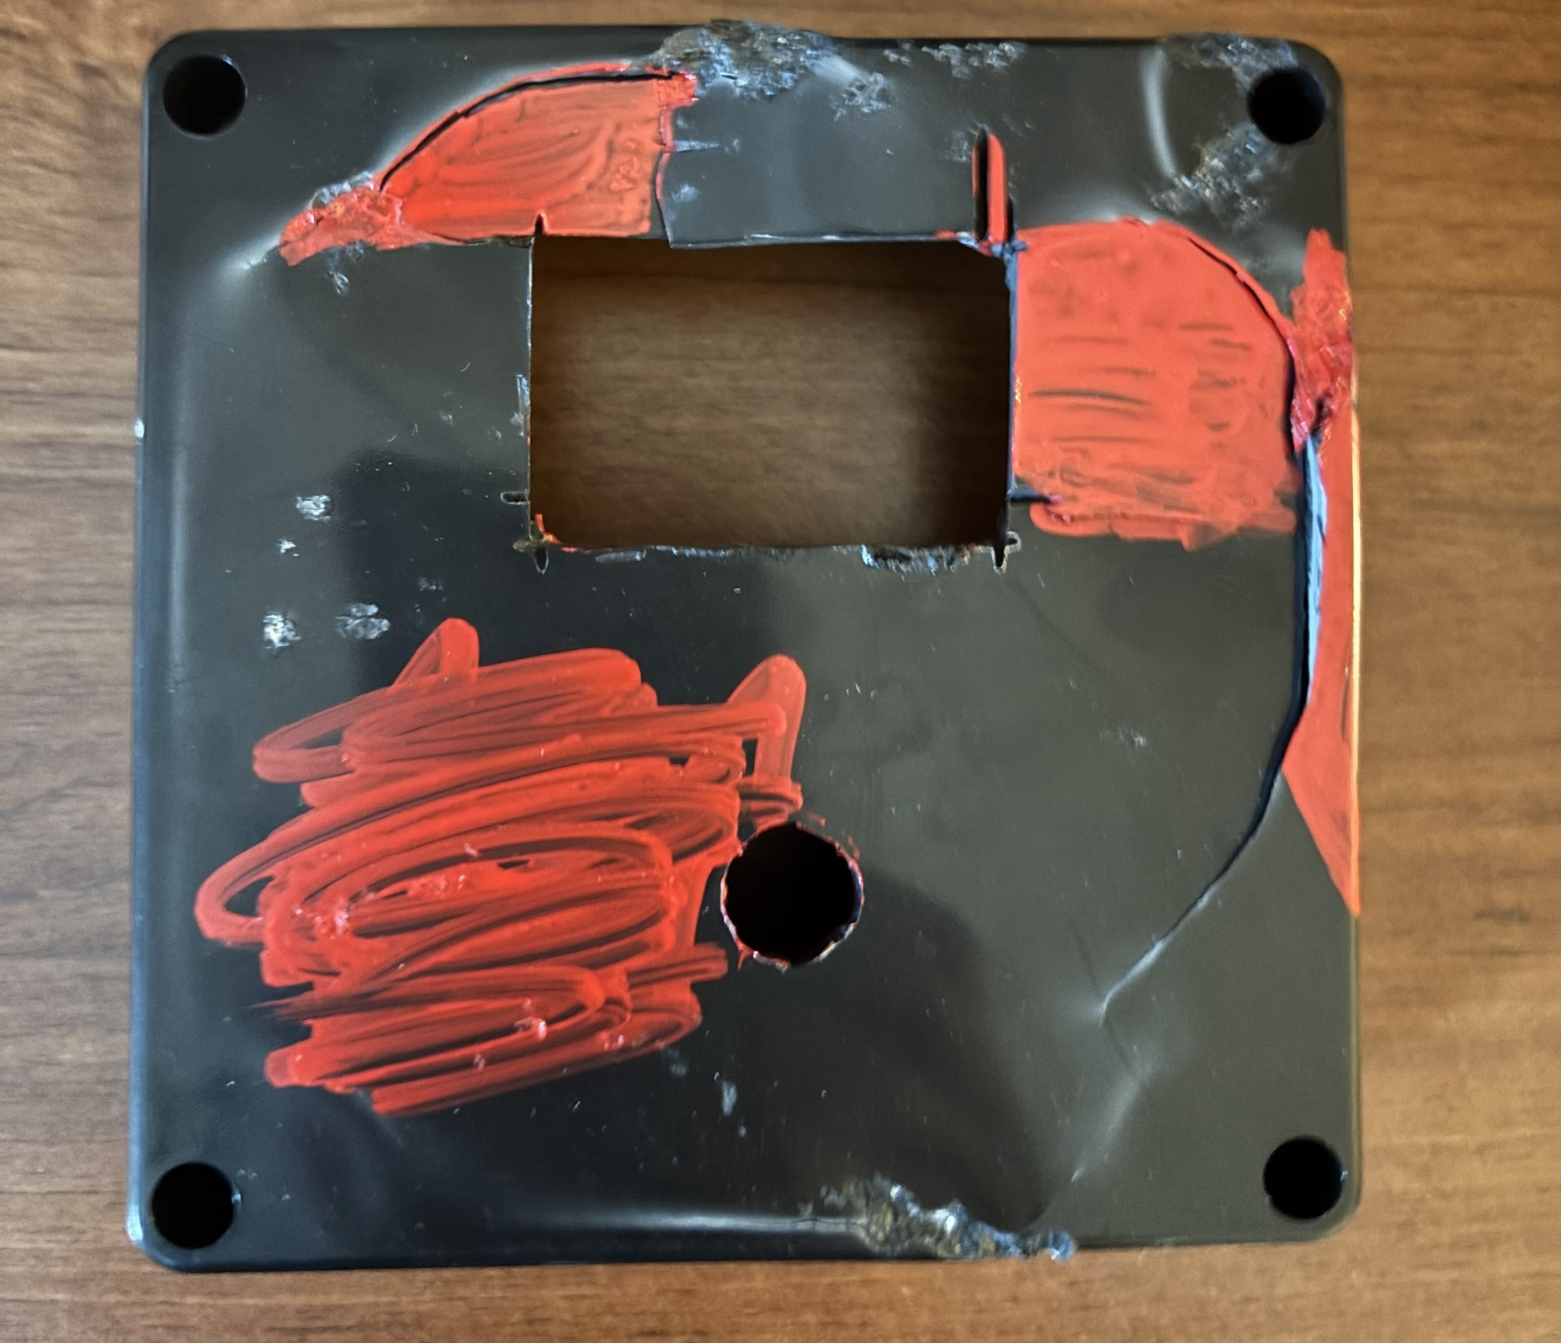
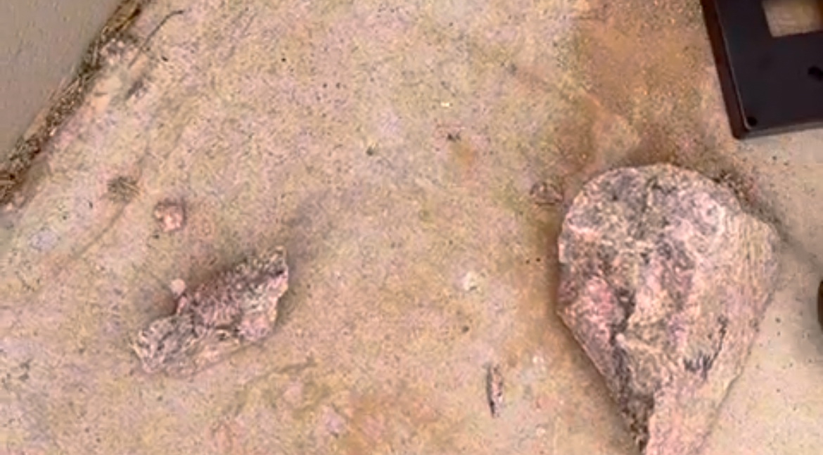
Endurance Testing

Slide 12
Enclosure
Axel Carrera
Zacheria Buchanan
Aliceanna Villanueva

Slide 13
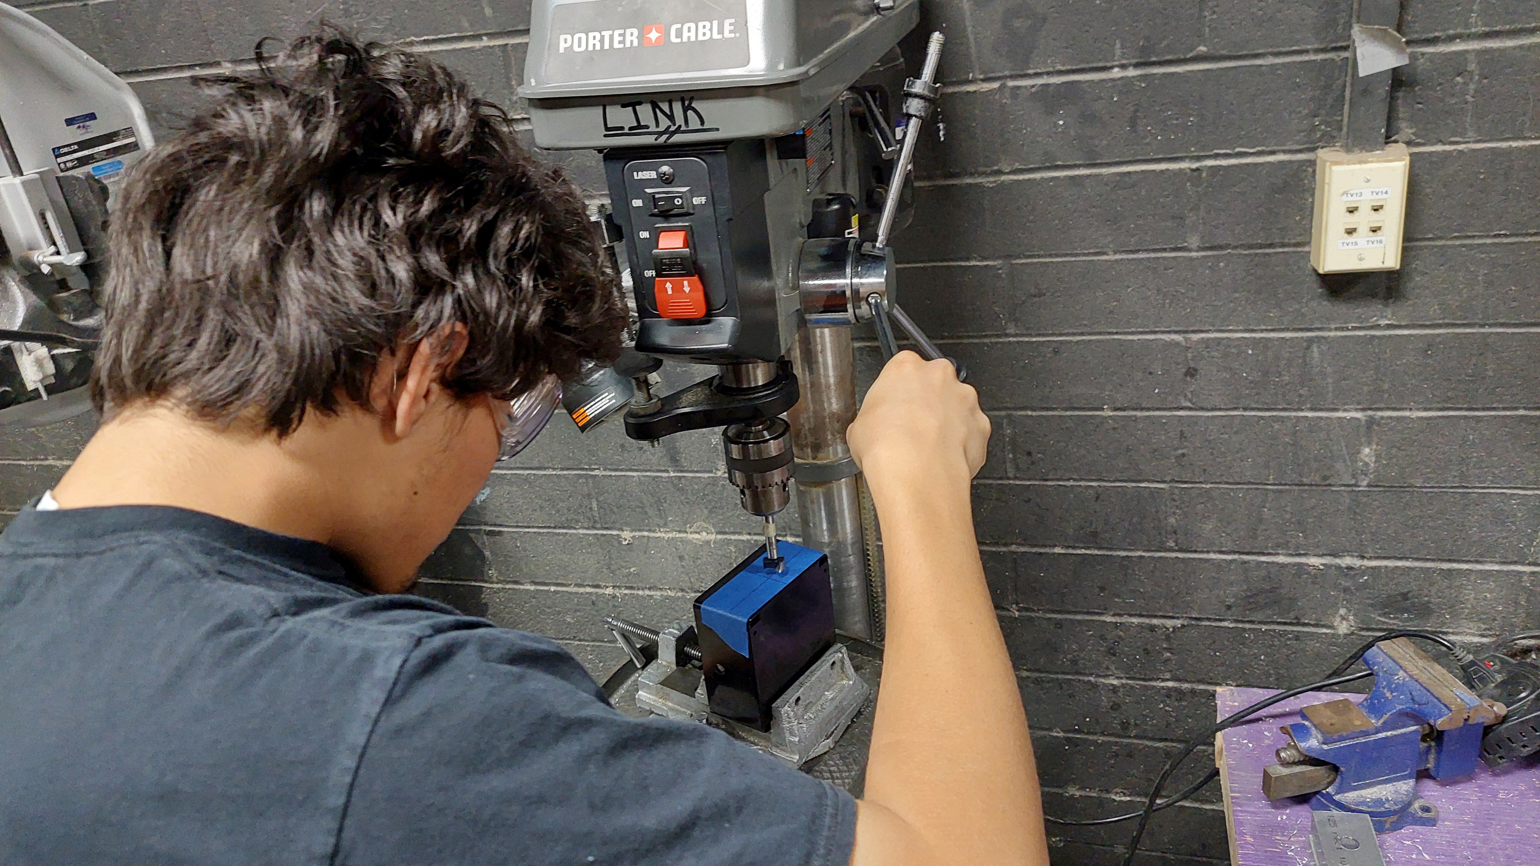
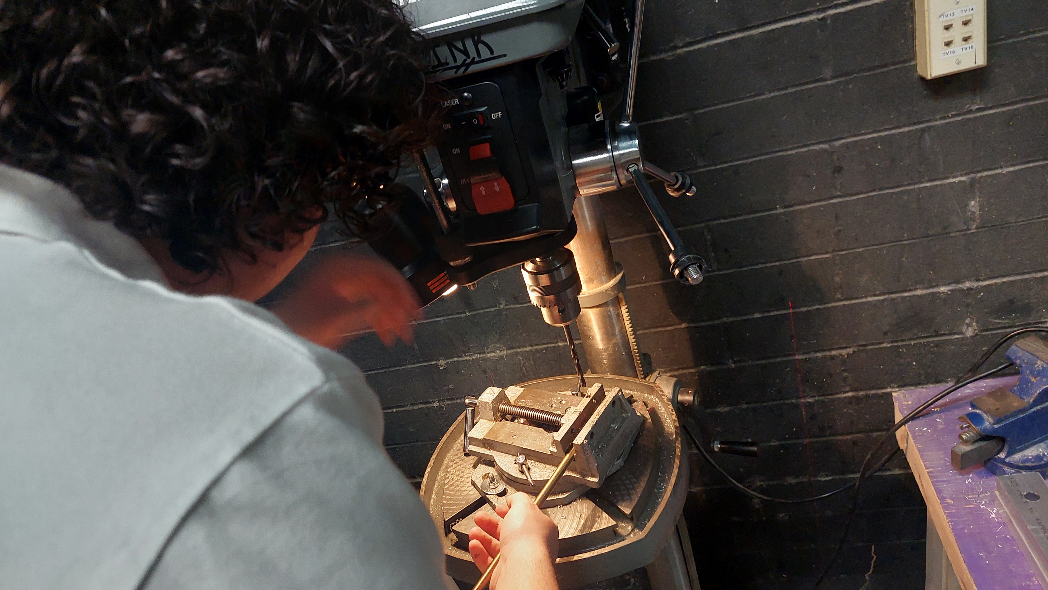
Enclosure
Requirements
Development
Testing

Slide 14
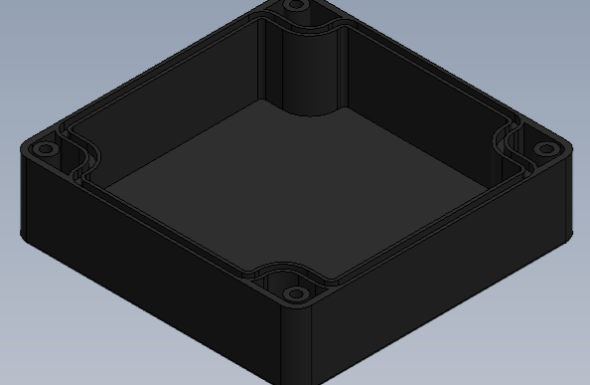
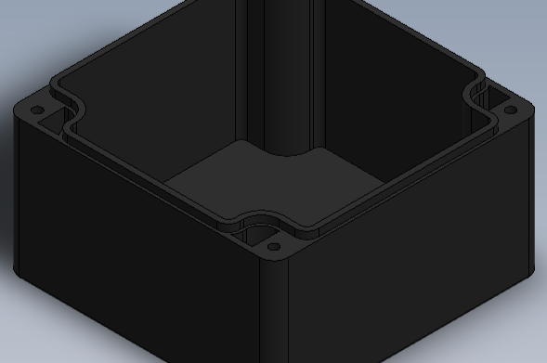
Original CUBESAT Idea
Transition to the ABS box
How the CAD was made

Slide 15
Control System
Hailianna Rodgers
Peyton Posey

Slide 16
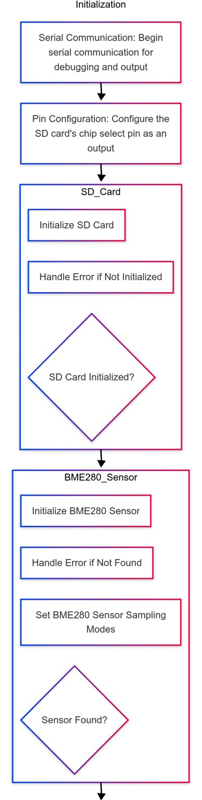
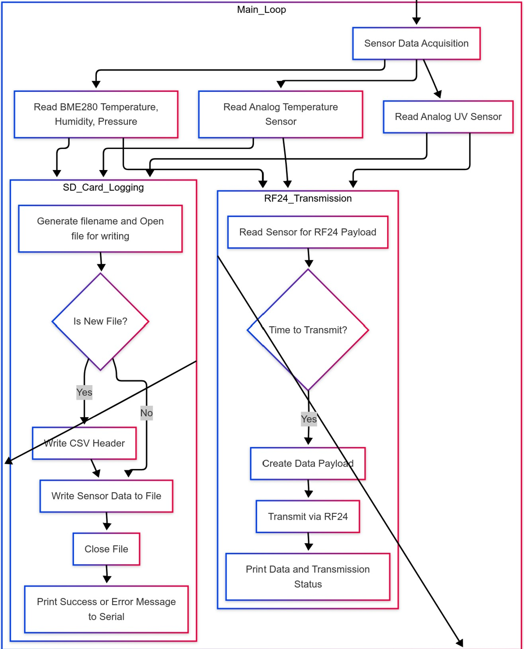
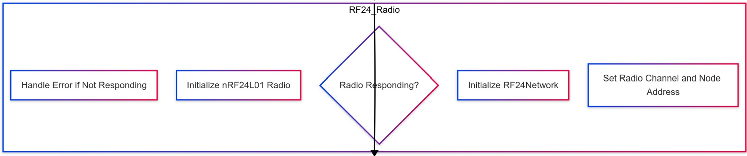
Code Schematic

Slide 17
Electrical
Emily Geen

Slide 18
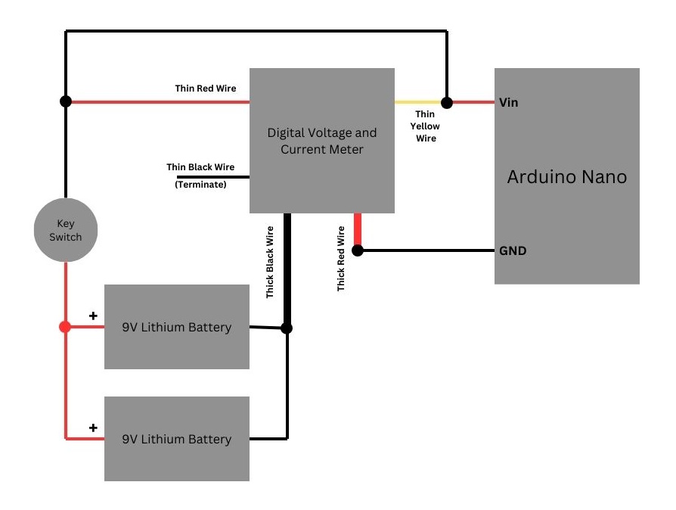
Power Distribution System

Slide 19

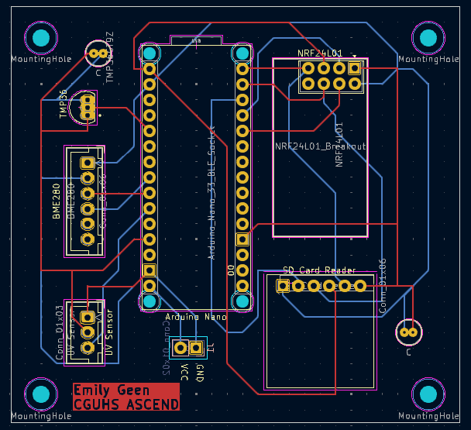
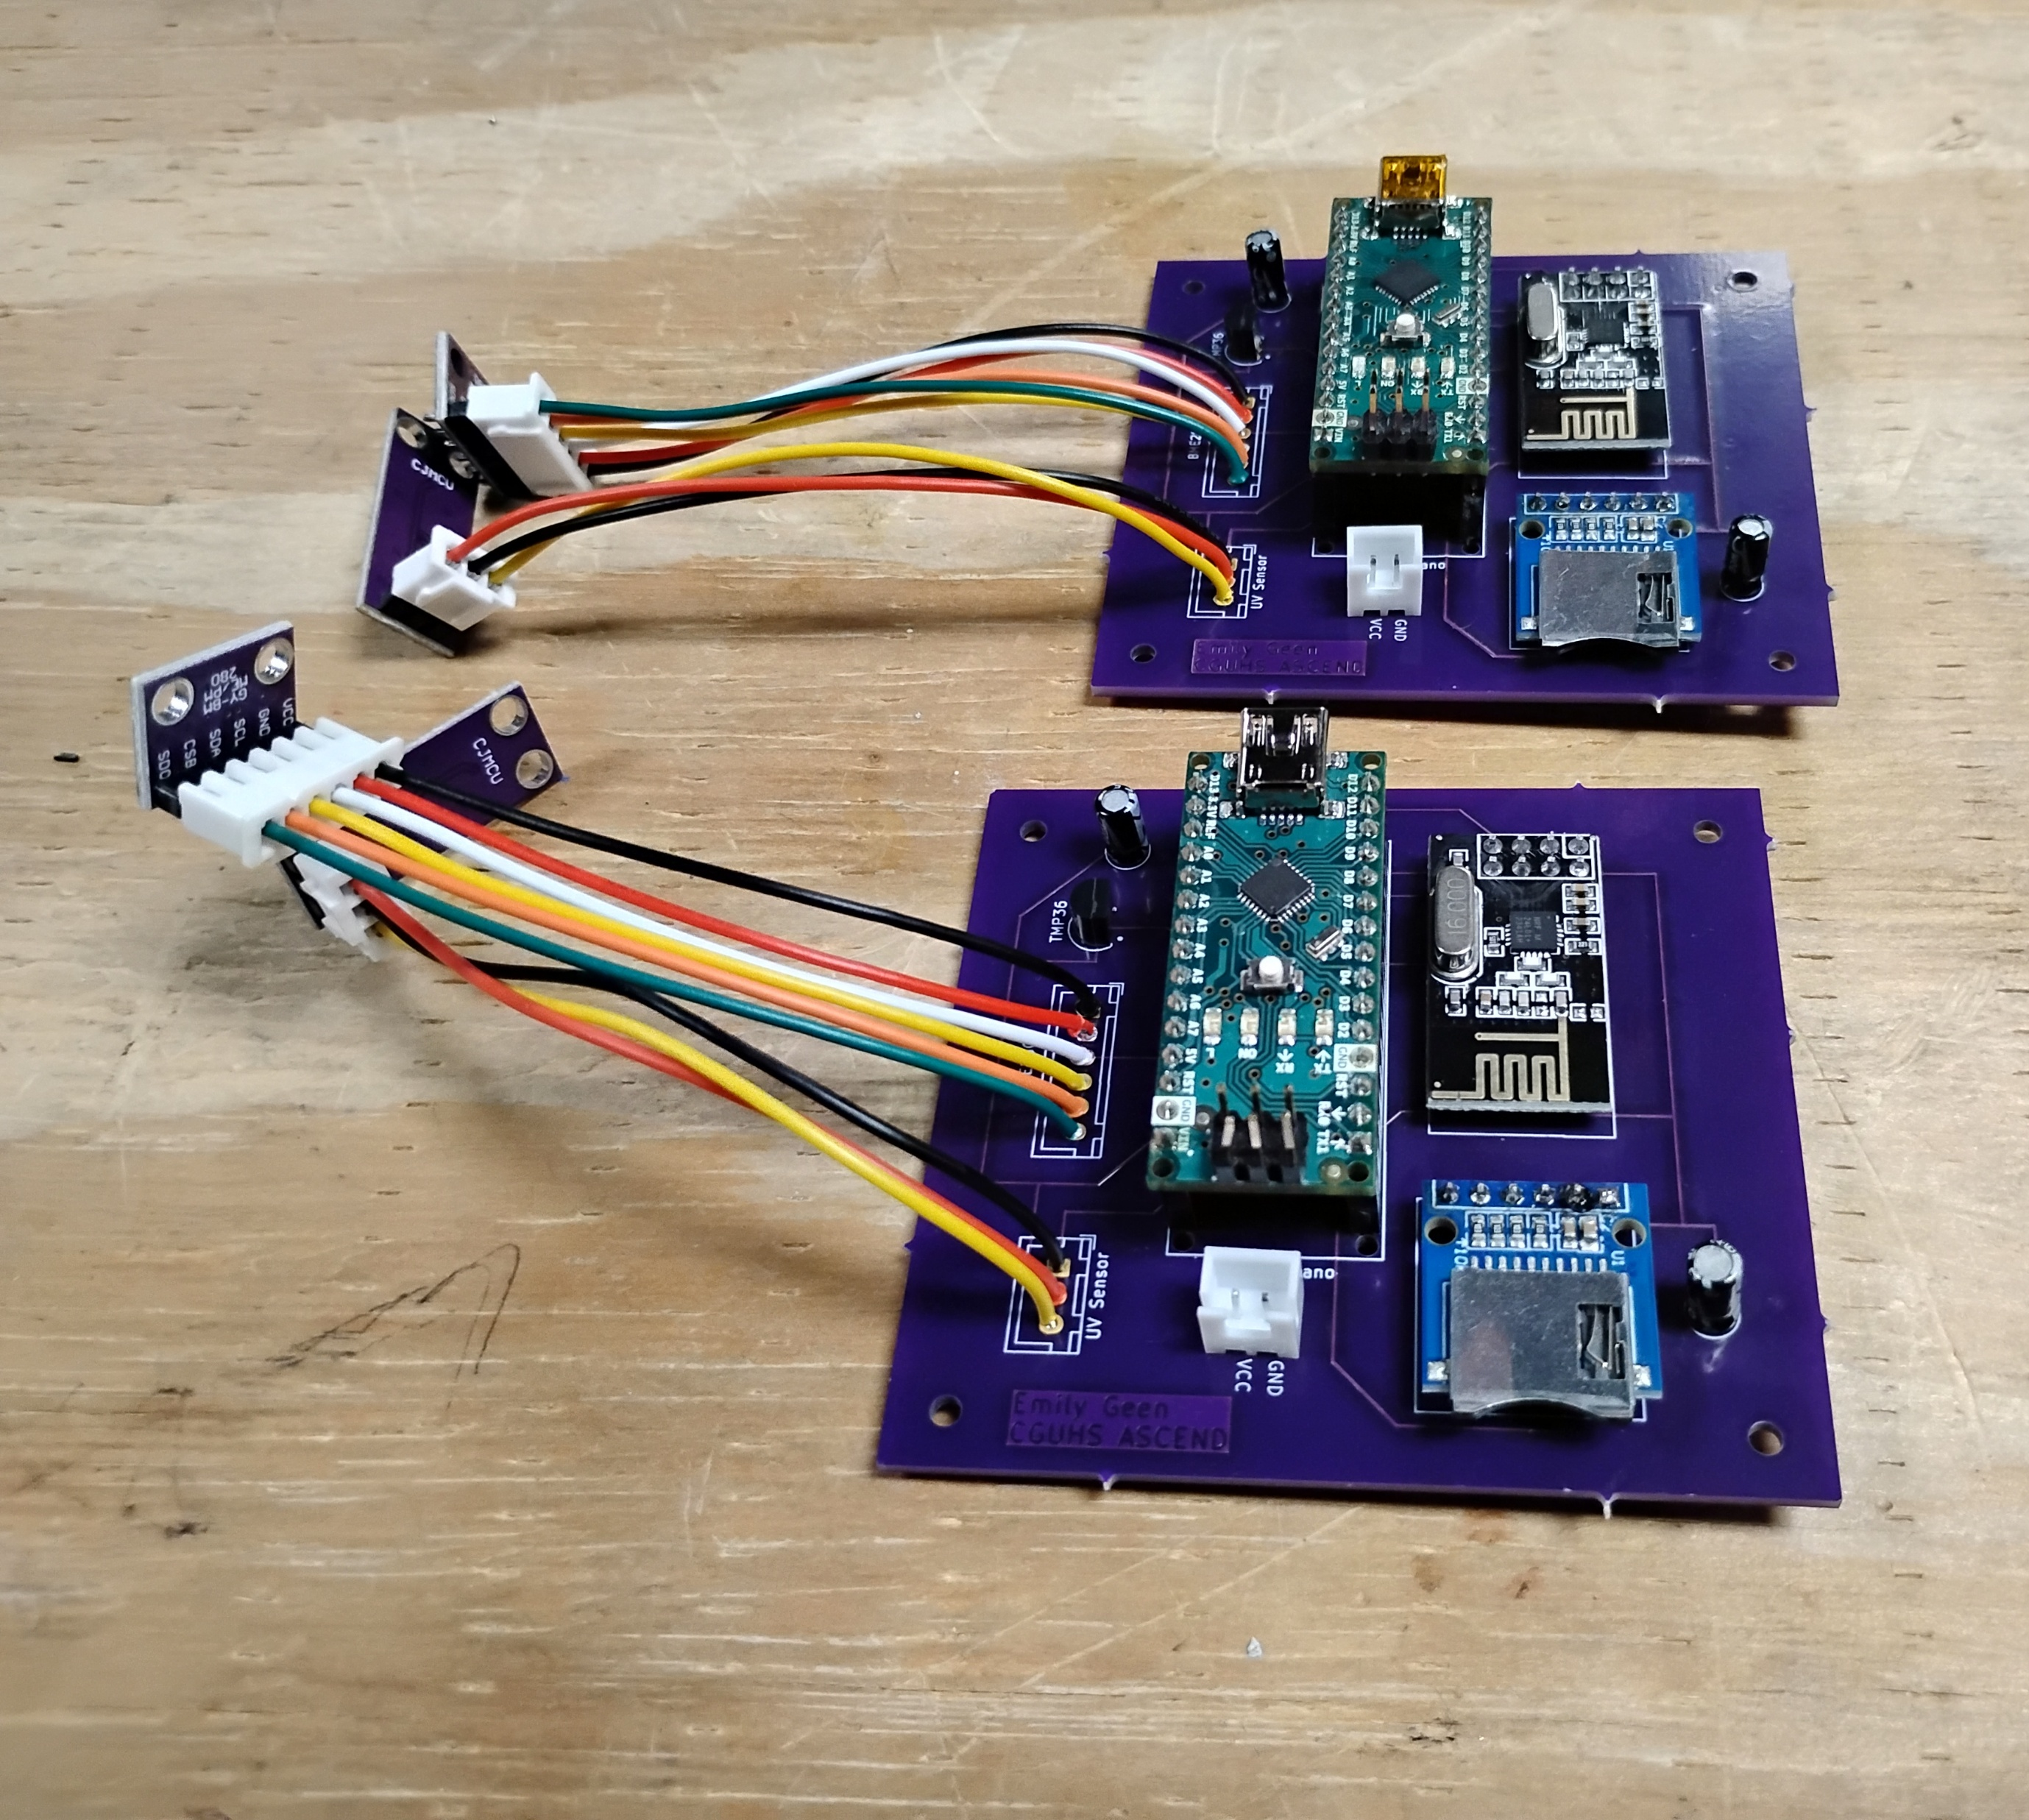

Custom Printed Circuit Board

Slide 20
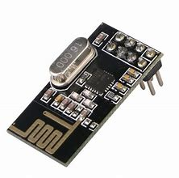
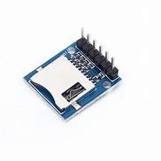
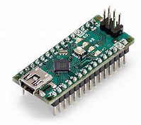
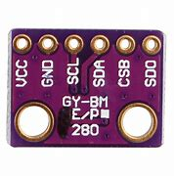
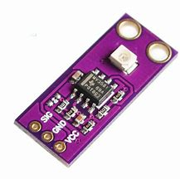

Sensors and Electrical Components
Arduino Uno
NRF24L01
SD Card Reader
BME280
GUVA-S12SD UV Sensor
TMP36

Slide 21
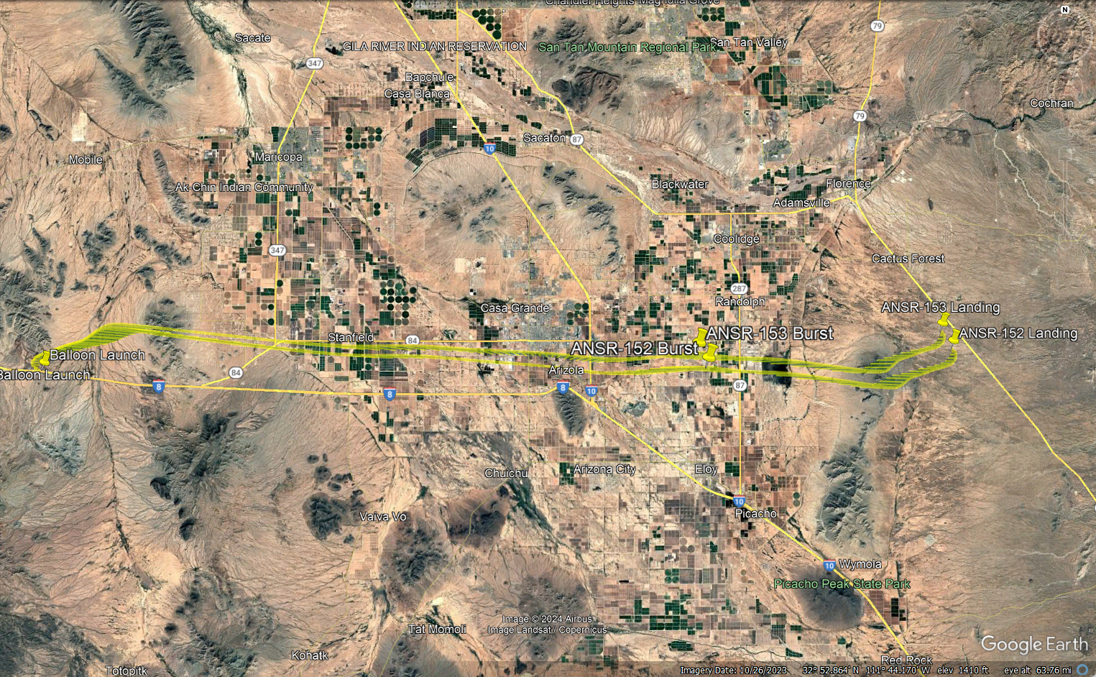
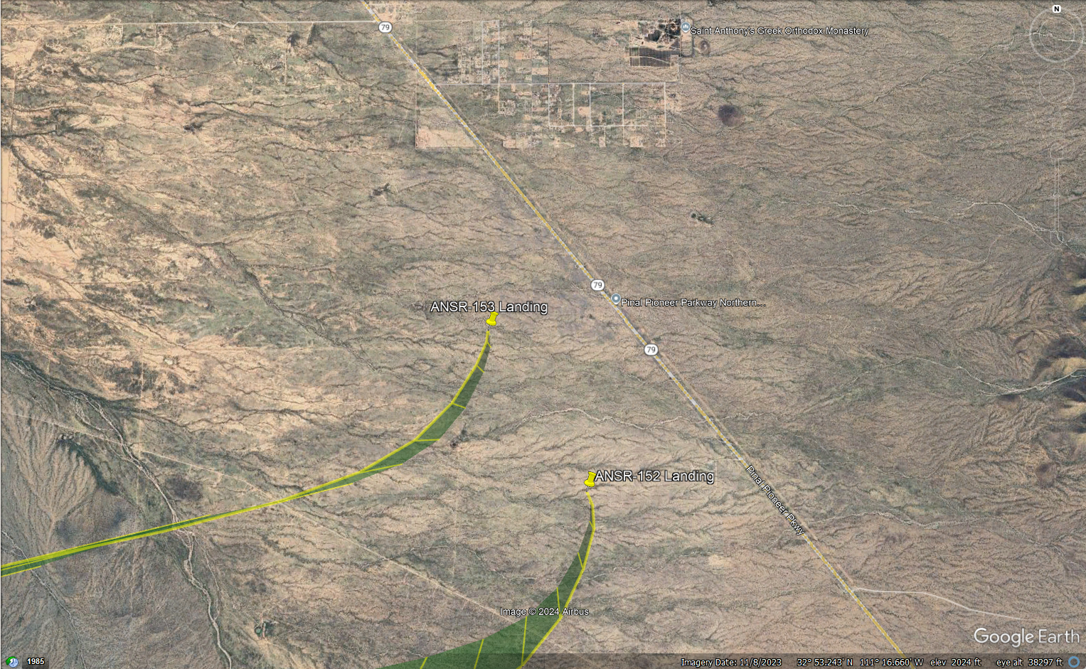
ASCEND Flight 51
November 24, 2024
Flight Distance 98 km (61 miles)
Landing at 32° 52.256'N, 111° 16.351'W, or 29 km (18 miles) northeast of the town of Eloy, Arizona near Highway AZ-79.
Burst occurred after 62 minutes with a total flight time of 94 minutes.
Payload mass of 8.7 kg (19.2 lbs),
Neck lift of 12.1 kg (26.5 lbs),
Ascent rate of 7.88 m/sec (1551 fpm)
Burst altitude of 29,656 meters (97,300 feet).
Descent rate at landing of 6.8 m/sec (1339 fpm)

Slide 22
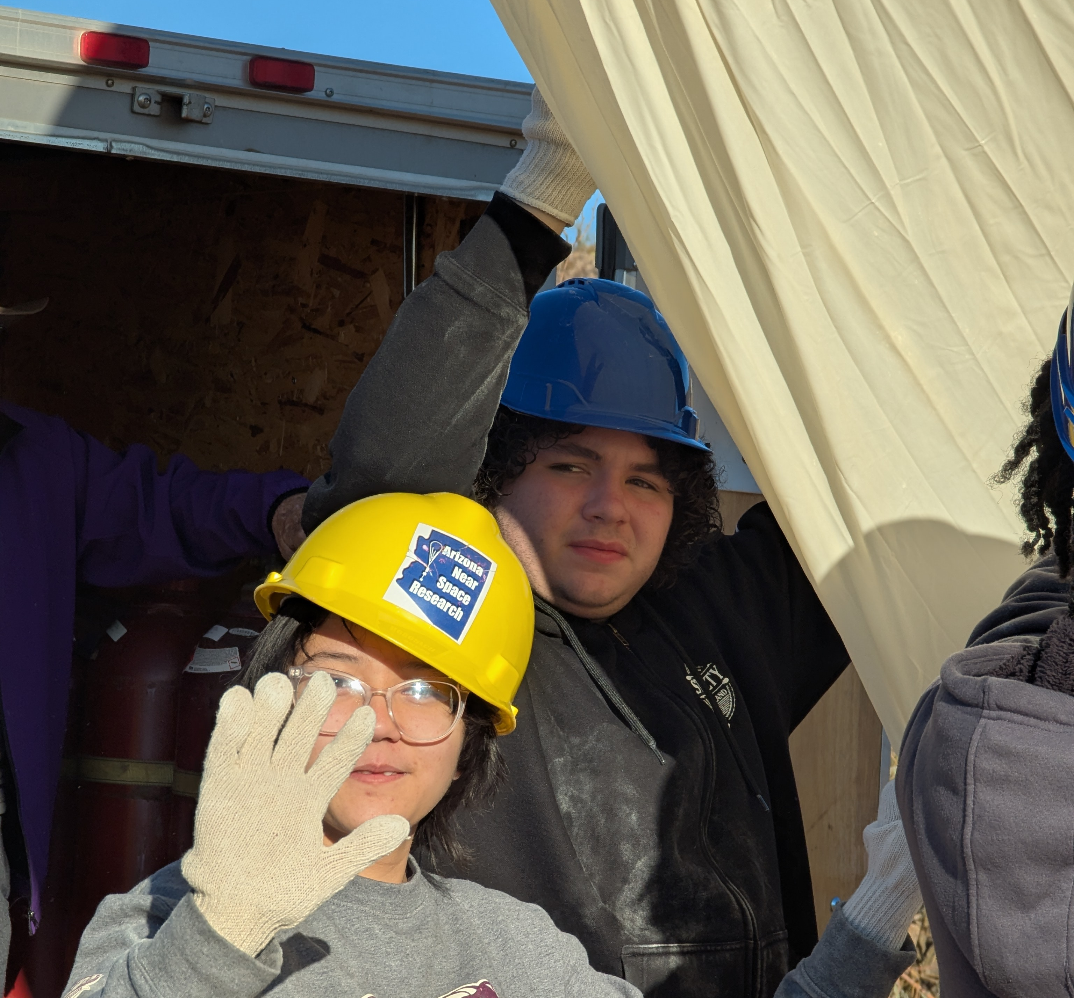
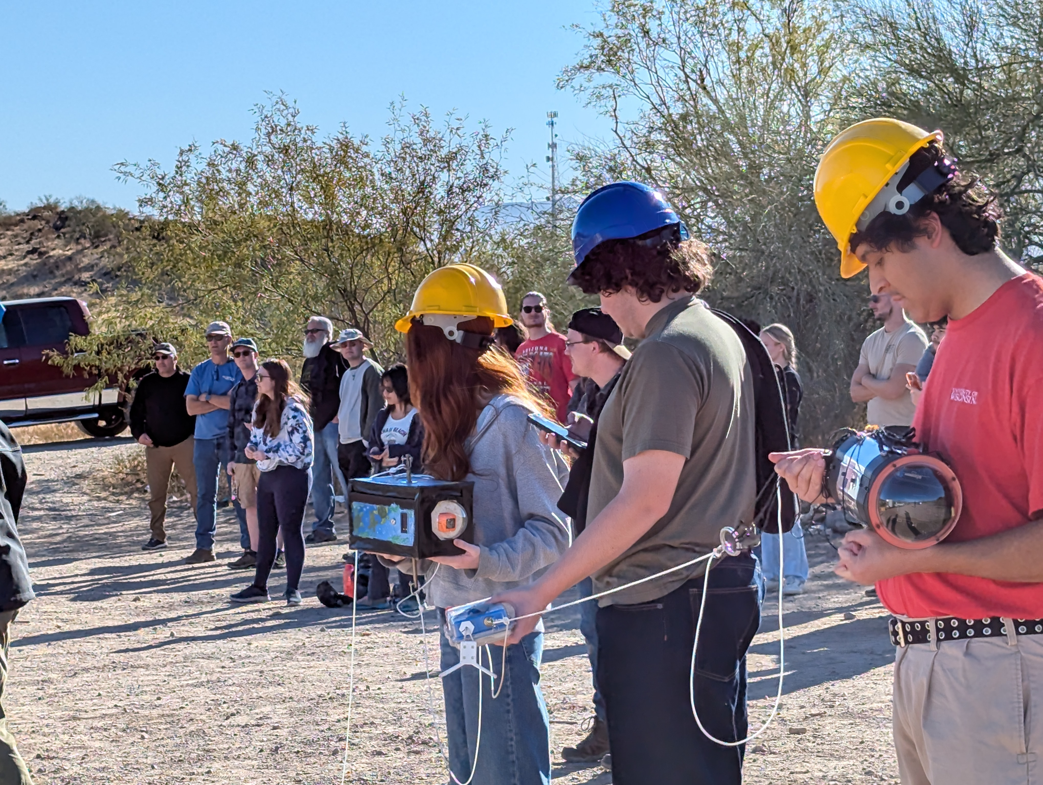
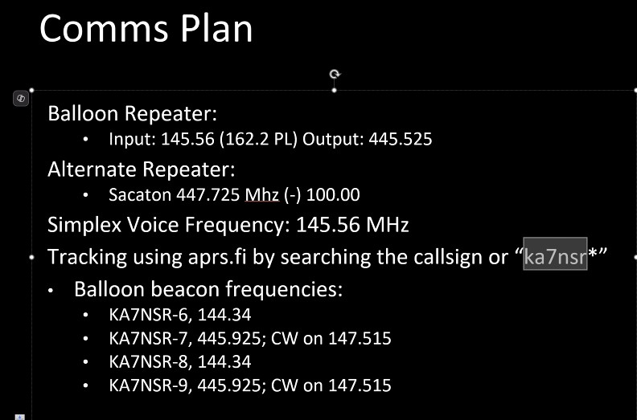

Slide 23
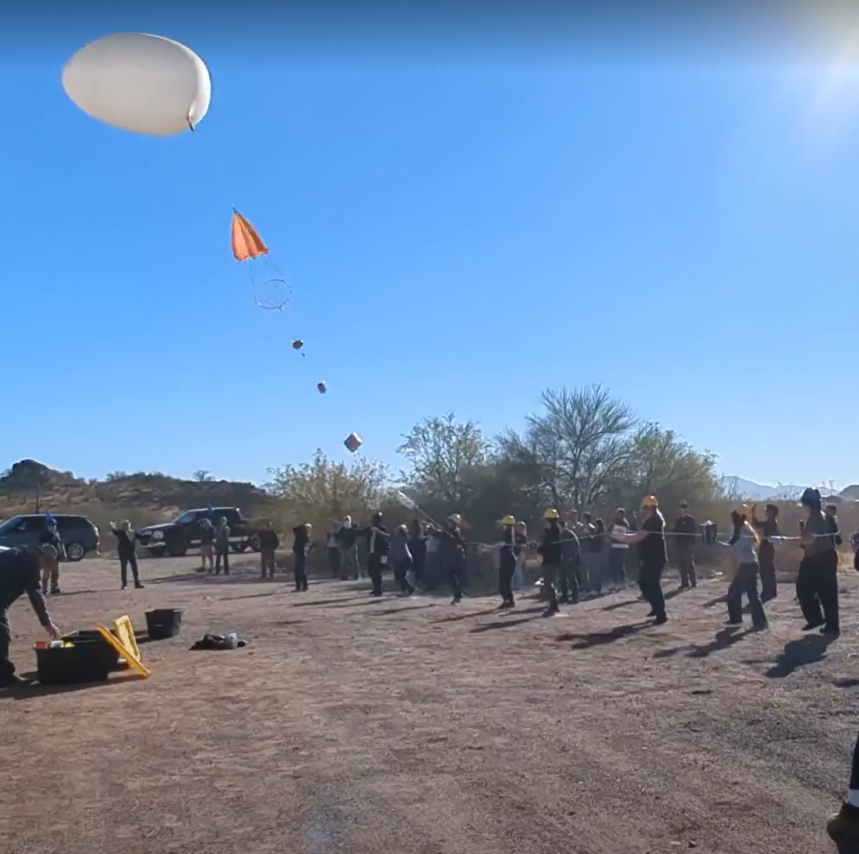
Launch

Slide 24
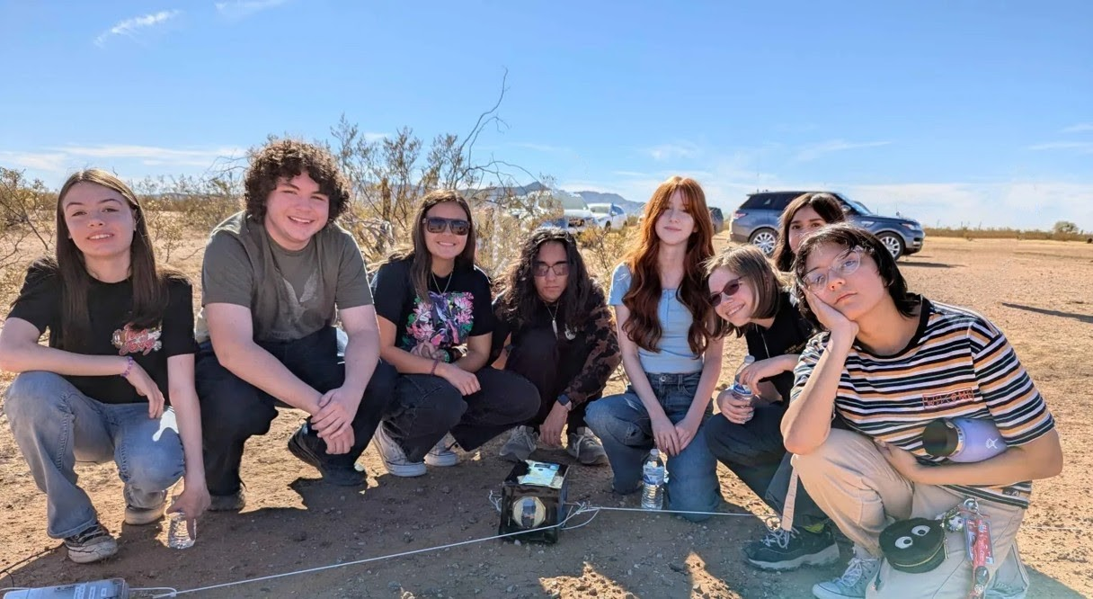
Landing Site – Fall 2024

Slide 25
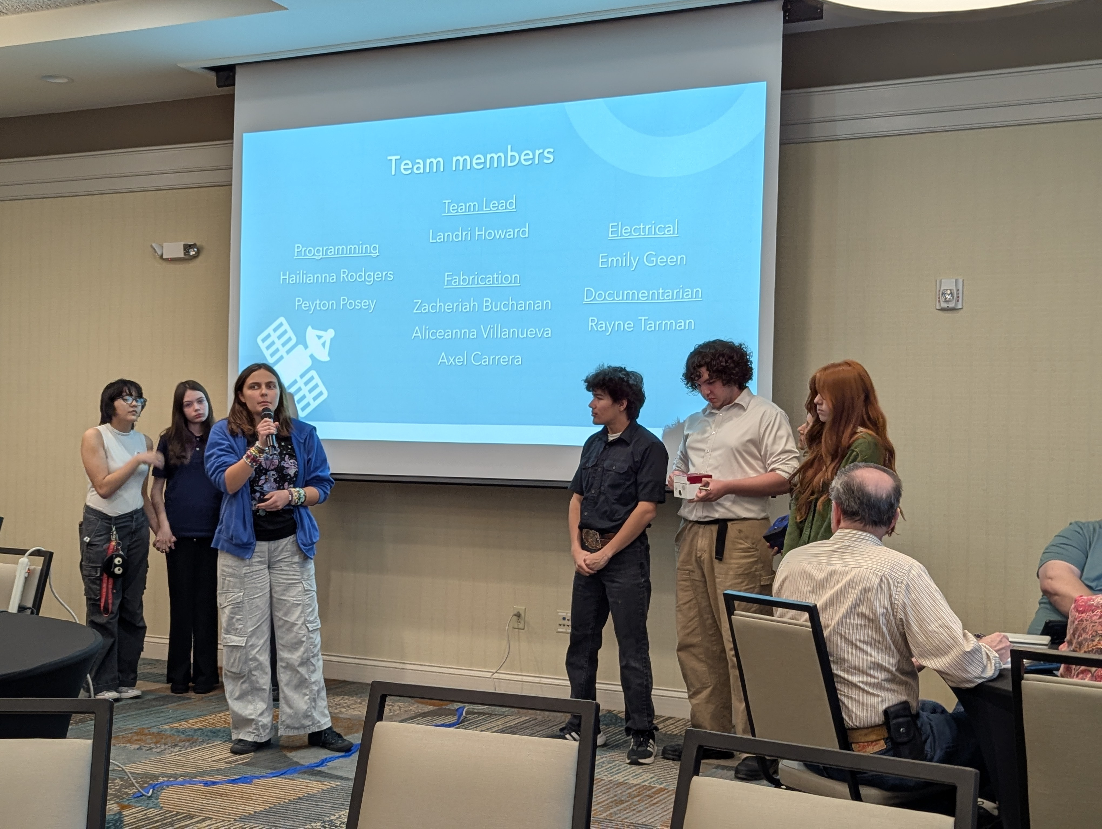
Pre-Launch Briefing

Slide 26
ASCEND Fight 55
March 29, 2025
Flight Distance 99.1 km (61.6 miles)
Landing at 32.78597,-111.22348, or 17.8 miles SE of Florence, AZ.
Burst occured after 63 minutes with a total flight time of 94 minutes.
Payload mass of 8.278 kg (18.251 lbs),
neck lift of 11.59 kg (25.49 lbs),
Ascent rate of 7.68 m/sec (1511 fpm)
Burst altitude of 29,869 meters (98,000 feet)
Descent rate at landing of 6.81 m/sec (1340 fpm)

Slide 27
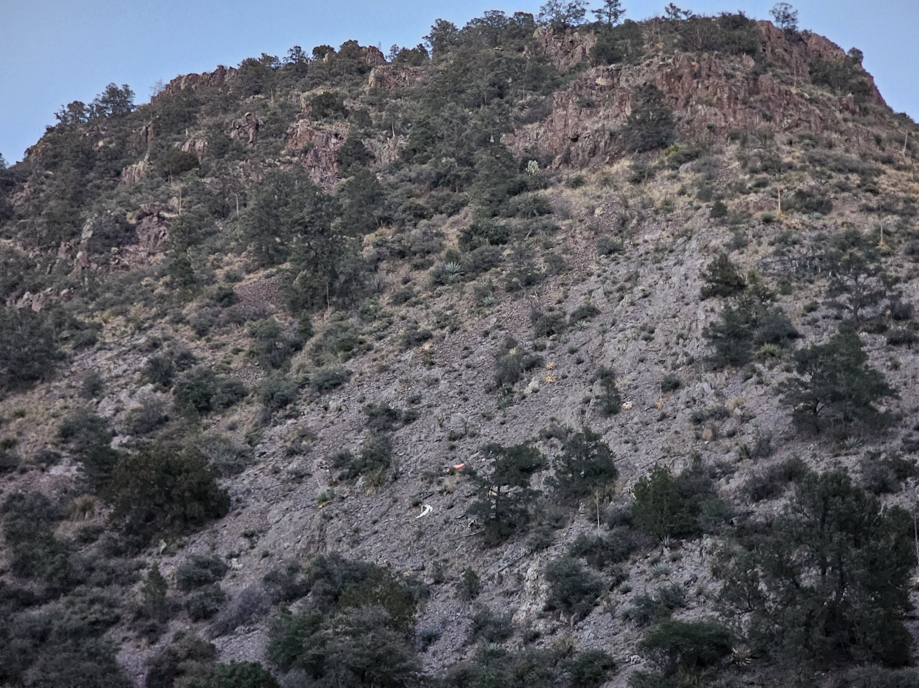
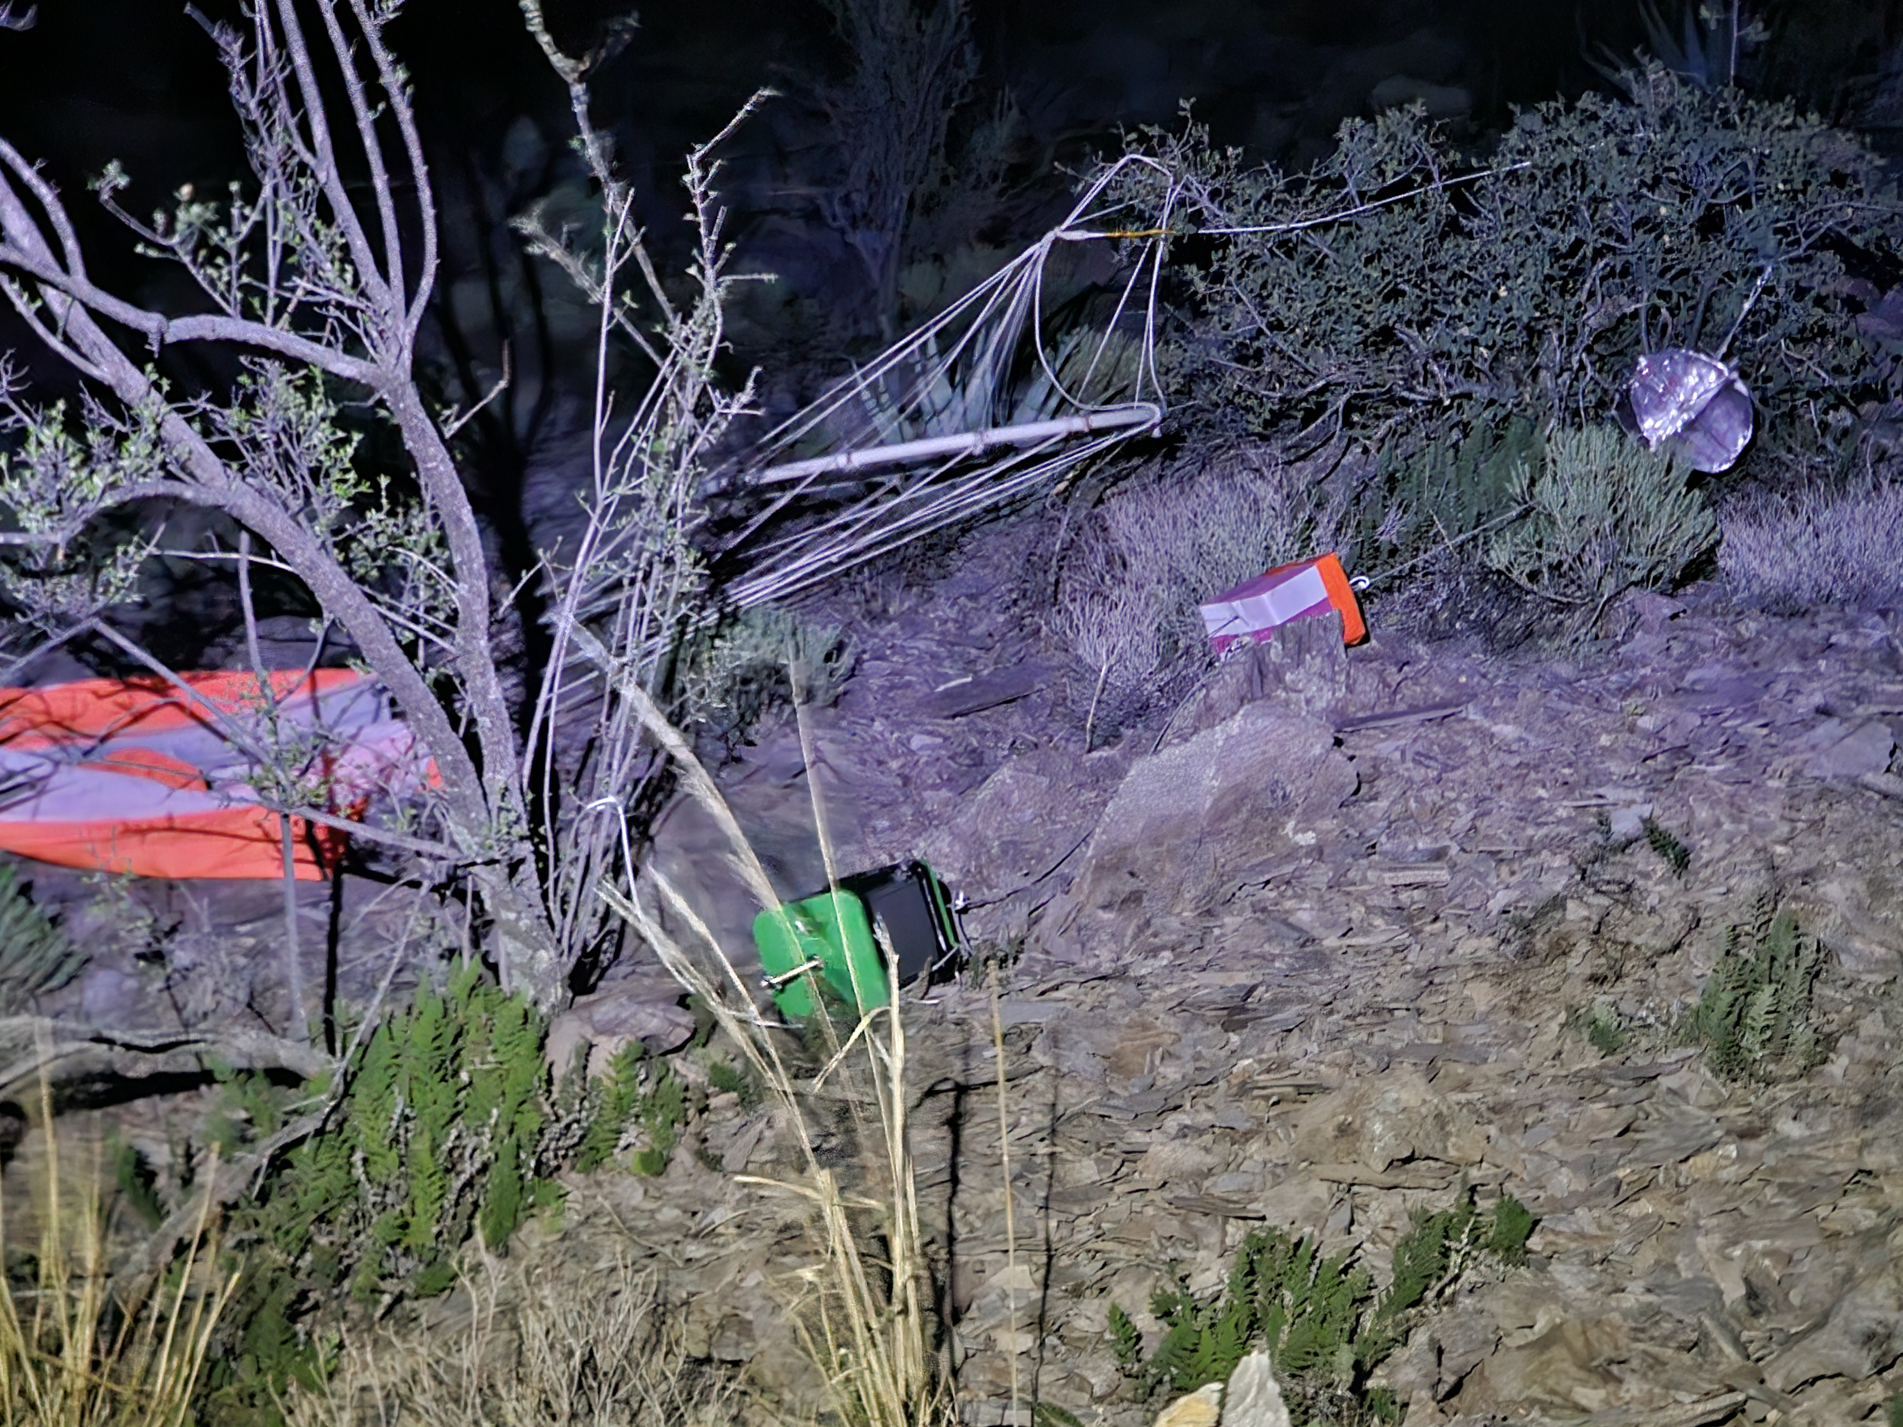
Landing Site – Spring 2025
By the time we had arrived at Oracle, burst had occurred, and the balloon payload was descending.
We rallied at the Circle K in Mammoth, and by that time the telemetry showed that the payload had landed at an altitude of about 6100 feet near Klondike.
Since Klondike is a ghost town with no maintained roads and it was by this time 3 pm, it was decided that one of the vehicles with off road ability would make the payload retrieval.
The rest of us headed for home.

Slide 28
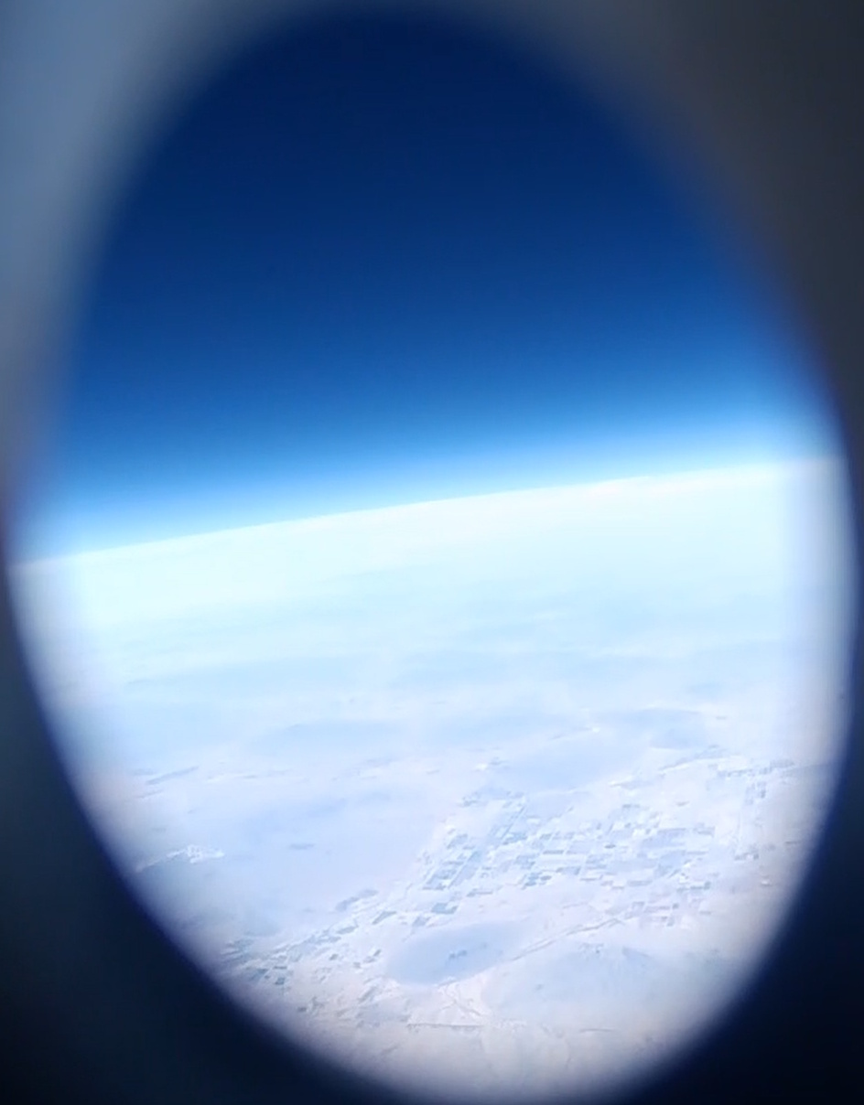

Slide 29
Future Work
Given the unsuccessful completion of Phase I and Phase II, the immediate future plans for this project must focus on a thorough failure analysis and a revised, more incremental approach. The primary goal shifts from rapid advancement to establishing a solid foundation of basic functionality.
Immediate Next Steps:
Comprehensive Failure Analysis
Focused Re-evaluation of Phase I
Iterative RF Communication Testing
Prioritize Reliability over Complexity
Staged Integration
Documentation and Knowledge Sharing

Slide 30





Acknowledgements
Michelle Coe
Manager,
Arizona/NASA Space Grant Program
University of Arizona
Clayton G. Jacobs, KJ6QJS
President, Arizona Near Space Research www.ansr.org
Stephen Thomas, KE7TLS
Vice President,
Arizona Near Space Research
Shirley Campbell
Assistant Director
National Space Grant Foundation
John Morris
Certified Educator
Engineering | Software and App Design

Slide 31


Thank you!

Slide 32
Questions?

